Slide 1

Optimizing New Disneyland
Vitchuda Poonyakanok & Shifan Huang

Slide 2
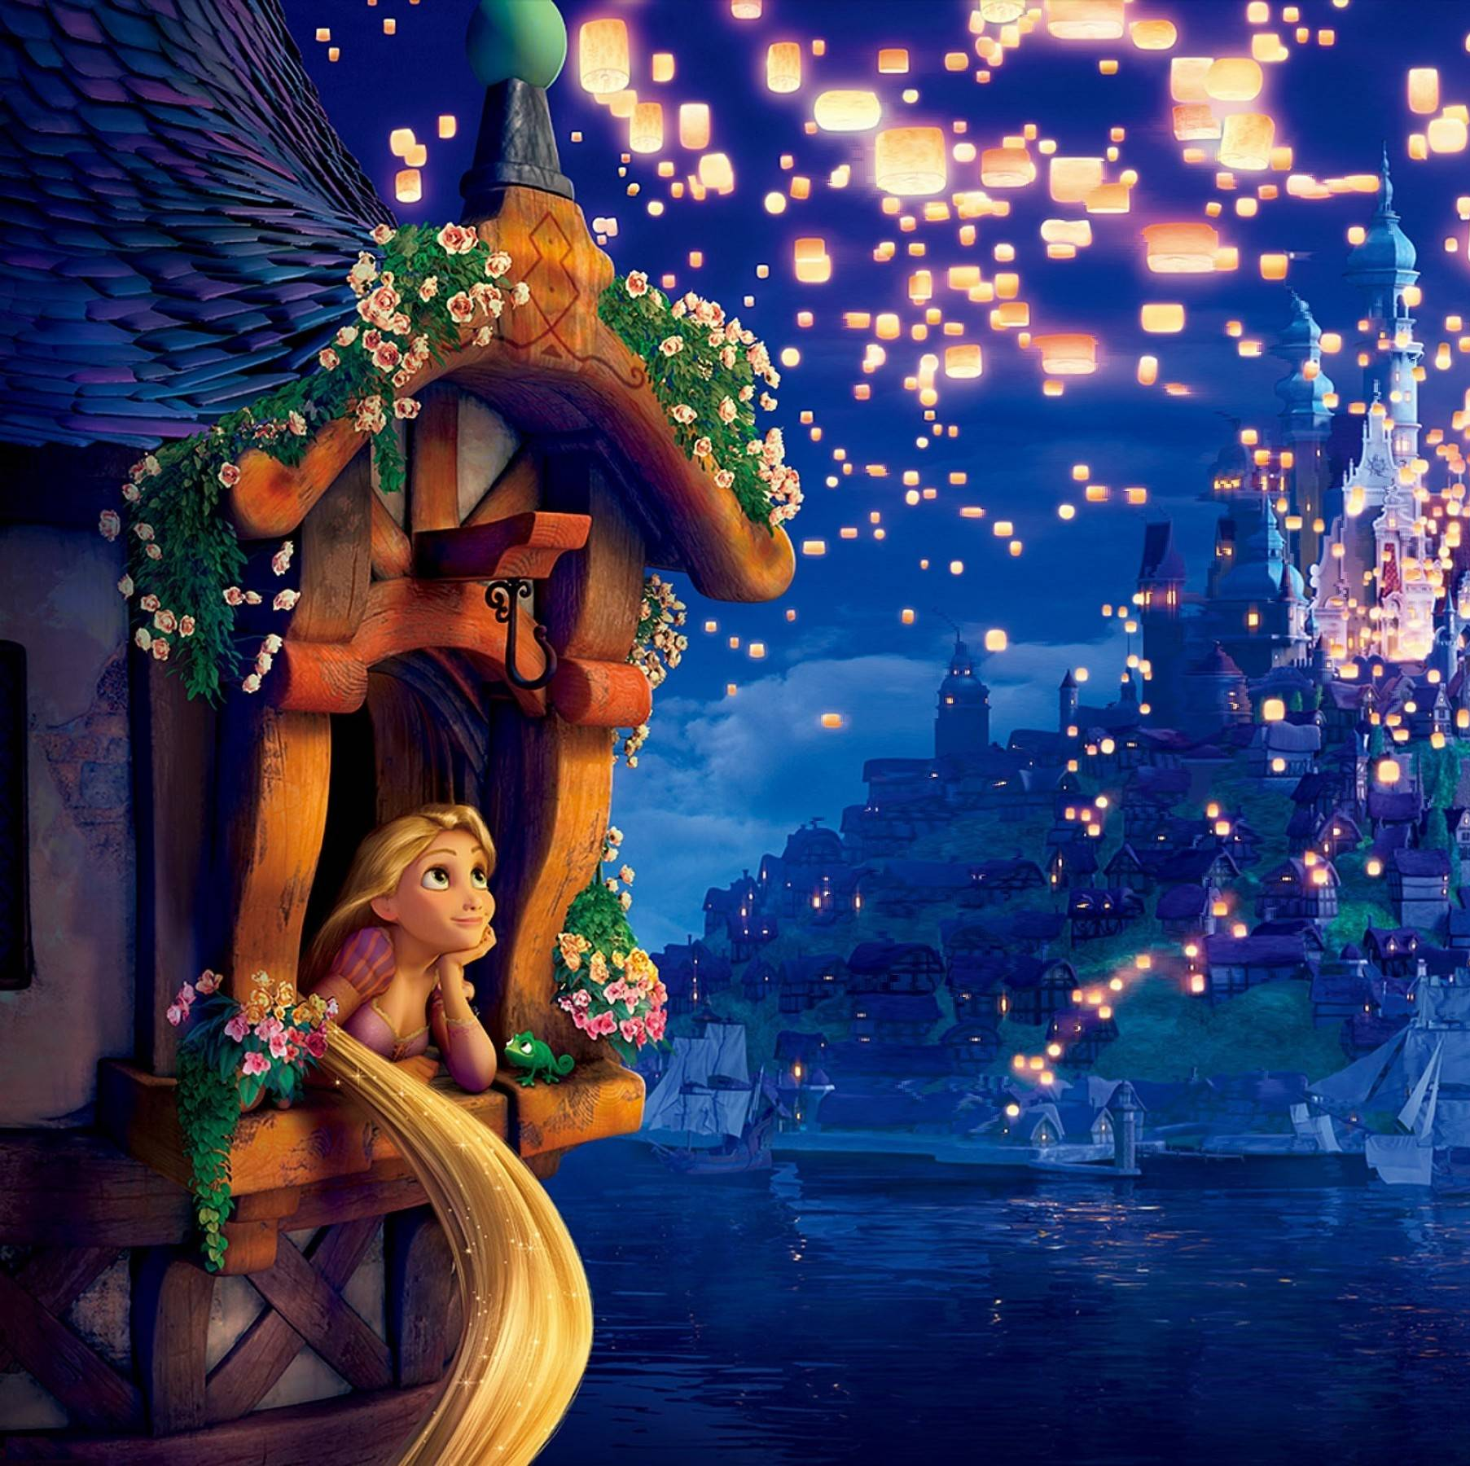
Background
Disneyland is a famous amusement park in the world. Now, there are in 5 countries; US(2), Japan(1), China Mainland(1)+Hongkong(1), France(1)
So, as they try to reach out all regions to expand their customer base, they plan to locate 3 new Disneyland

Slide 3

Idea
Create an optimization program that automatically select 3 locations maximize profit within the budget
The factor could include GDP, population, weather score and country location etc.

Slide 4
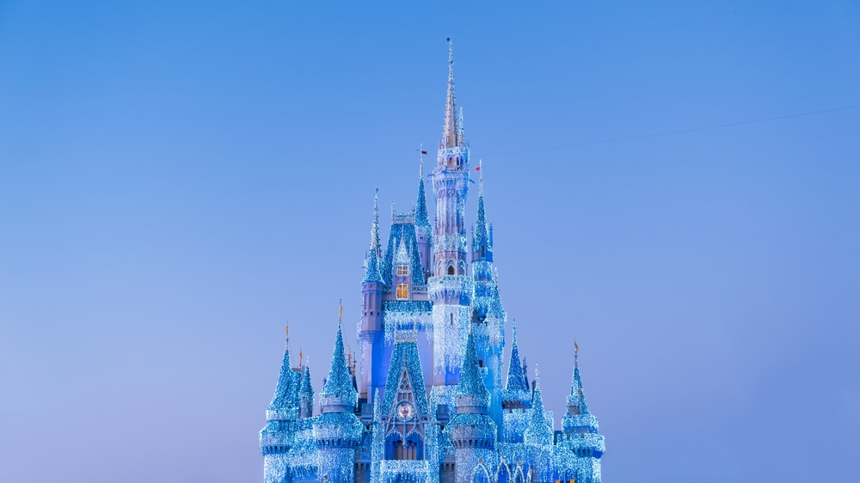
Optimization Model
Key Objective: Maximize 20-year profit from New Disneyland base on revenue and cost that can be vary on number of attendance
Maximize : Net present value of profit from
Sum(Revenue from average ticket fee + souvenir & food*attendances) for 20 years
- (Cost from fixed cost + variable cost * attendances) for 20 years
- set up cost at the fist year
How to solve? : Allocation method by setting binary decision variables in each country (build or not) and use LP solver to maximize profit

Slide 5
Assumption:
Number of attendances (generate by number of population in each country and divide by score that convert from GDP, population, Disney consumer base, weather)
Every year, number of attendance grows up 1%
Set up cost charge only in the 1st year
Fixed cost charge in each year (1 billions), and growth 1% per year
Ticket price increases 5% in every year (1st year = $200)
Souvenir&food revenue average $200 per attendance
Variable cost charge $50 per attendance on average
Discount rate = 5%

Slide 6
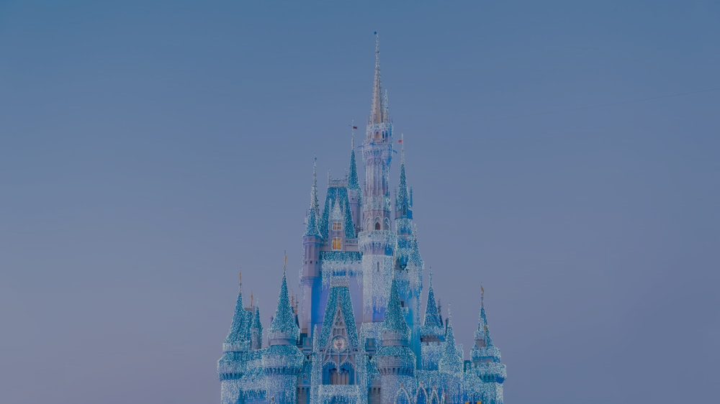
Constraints:
Select top3 country that can maximize profit within budget ($10 billion)
For new location, there are no more than 1 park in the same subregion and 2 parks in the same region
Cannot build in the same country to prevent from cannibalize demand
Remark:
We drop some country that does not have GDP and weather data
And we drop some country that has small area than 1000 km² and low GDP than 2500 billions. Because it is not a proper location to build amusement park.

Slide 7
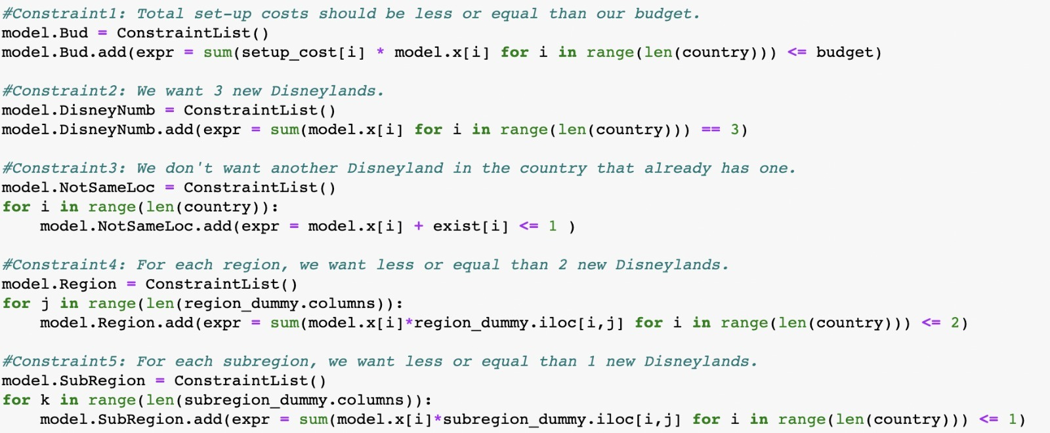
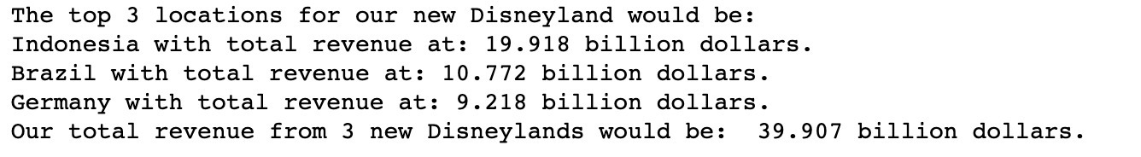
Link of coding file
Programming screenshot:
Constraints:
Result:

Slide 8

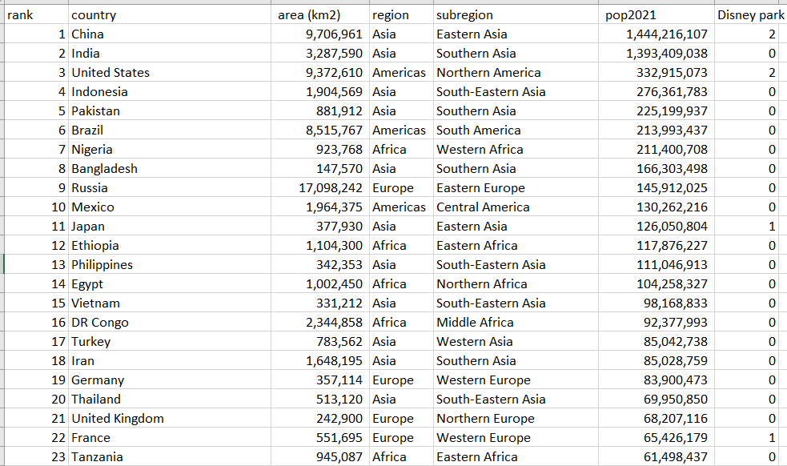
Data example
Link of data file

Slide 9

Hypothetical Client(s)
Disney company, or any company that want to set up new location.
Hence company can select new location which maximize their profit so that breakeven within 20 years
Next step
Company can include more other factors for calculation.
Since we have a limitation about the accessible of internal data; number of customer base in each country, number of visitors in each existing Disneyland. If we know that, we can estimate more accurate outcome.

Slide 10
Limitation
At first, we try to project the number of attendances by doing regression with the actual number visitors from existing parks data, however, the result is not reasonable. Therefore, we change the way to input it as score indicators.
It could have some significant several factors that impact Macro economy in specific country; force majeure, pandemic, recession. Therefore, our optimization cannot project the profit with 100% accuracy.
Contribution
We work together all processes. We select the Disney problem because we are obsessed with it and try to find what company should question about and relate to the coursework we learn. Moreover, since we know much about this company, it is easier for us to consider the objective, variables, and constraints they would have. Then we search for the information and data together and support each other for programming and presentation part.

Slide 11
Sources
https://datacatalog.worldbank.org/search/dataset/0040276
https://www.ocregister.com/2021/08/20/how-will-disneyland-determine-reservation-capacity-limits-for-magic-key-annual-passes/#:~:text=Disneyland's%20theoretical%20maximum%20capacity%20is,the%20Themed%20Entertainment%20Association%2FAECOM.
https://worldpopulationreview.com/country-rankings/how-many-countries-are-there
https://www.imf.org/en/Publications/SPROLLS/world-economic-outlook-databases
https://unstats.un.org/UNSD/snaama/Index
https://www.macrotrends.net/stocks/charts/DIS/disney/operating-expenses

